Slide 1
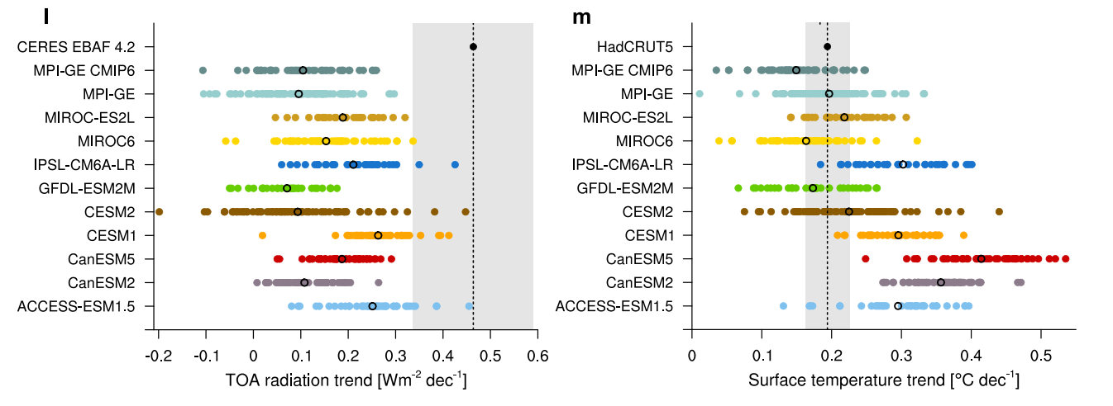
Coupled AOGCMs systematically understate the observed EEI trend
“…. coupled models with freely evolving ocean-atmosphere interactions systematically underestimate the observed global TOA radiation trend during 2001–2022 in 552 simulations…”
Olonscheck and Rugenstein (2024)
I have been trying to understand this via evaluation of AOGCM EBM parameters (e.g. feedback, forcing and heat uptake)

Slide 2
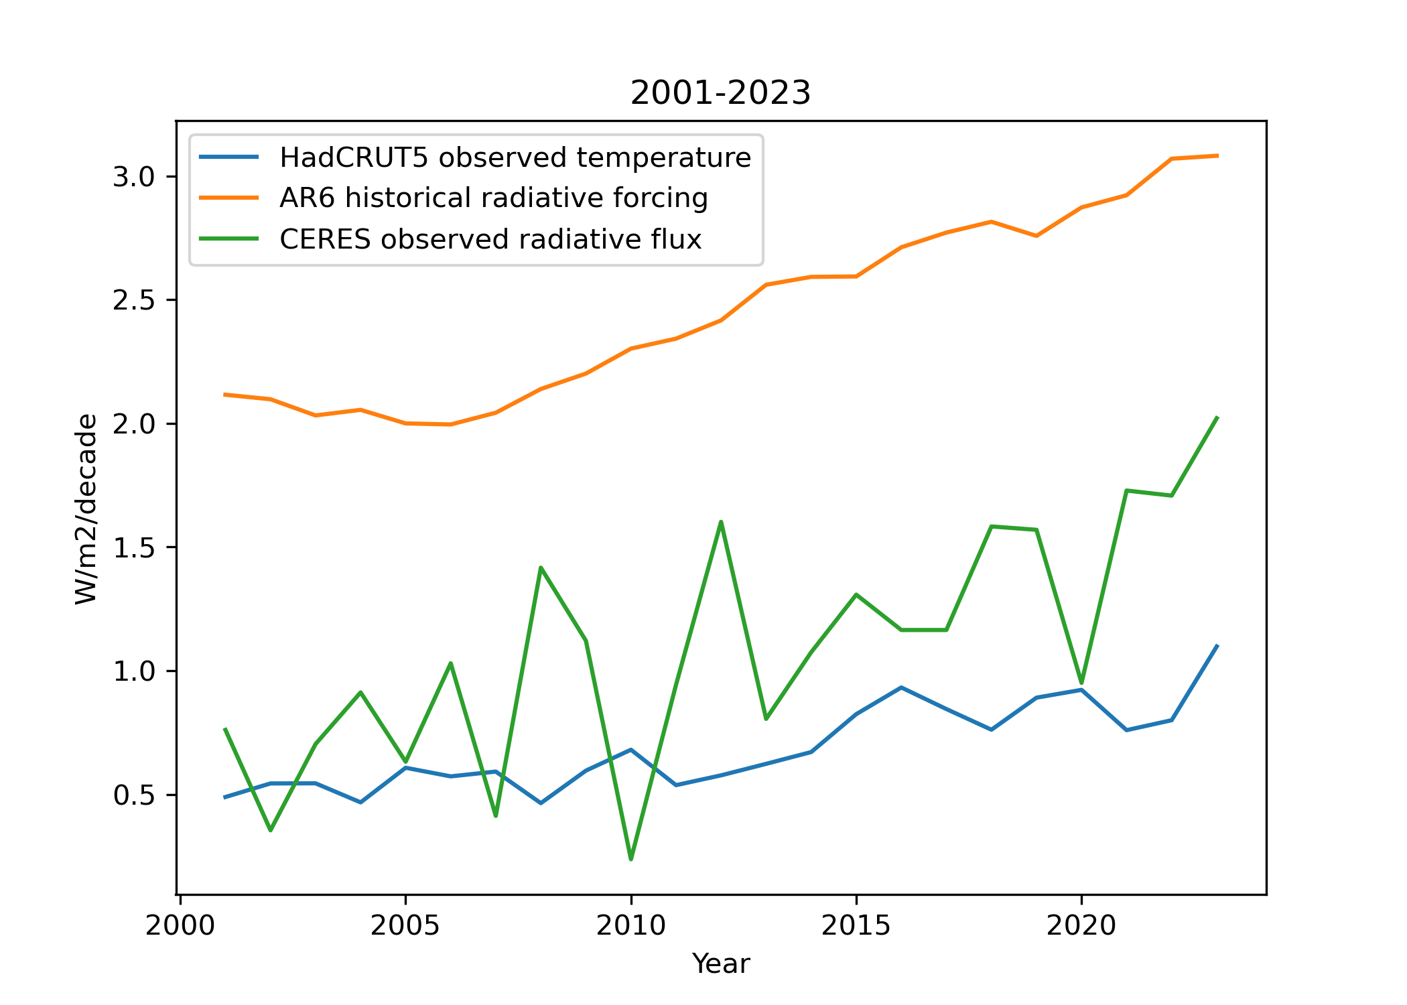
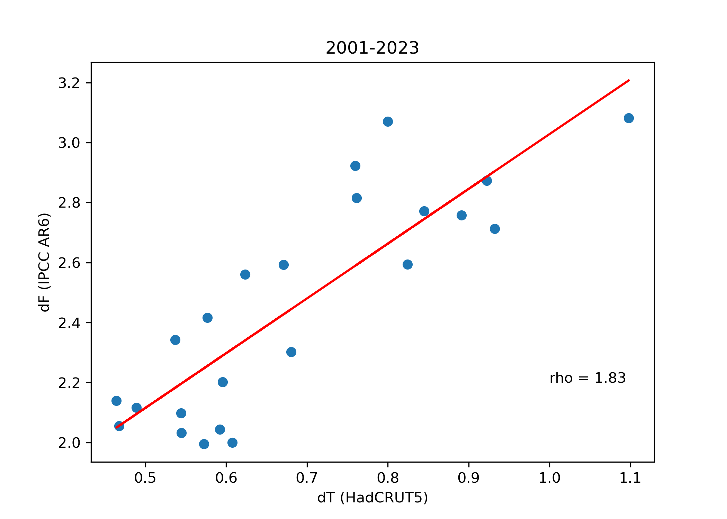
Observed trends and climate resistance (ρ) (2001-23)
Apply simple model to try to understand where AOGCMs might be missing something, allows us to diagnose climate resistance (ρ), climate feedback parameter (λ) and ocean heat uptake efficiency (κ) from dN, dT, and dF.
dF = ρ dT
dN = F + λ dT
ρ = λ + κ

Slide 3
Simulated 2001-2023 trends in 50 member HadGEM3-GC3.1-LL historical simulations
Can calculate the same quantities in AOGCMs.
Not just HadGEM3-GC3.1-LL but also CMIP6. Redistricted myself to those with large ensembles and RFMIP simulations to determine radiative forcing.

Slide 4
We also have Jan 2001- Dec 2024 trends in HadGEM3-GC3.1-LL amip (HadISST1.1 BCs; CMIP6 forcings)

Slide 5
We also have Jan 2001- Dec 2024 trends in HadGEM3-GC3.1-LL amip (HadISST1.1 BCs; CMIP6 forcings)

Slide 6
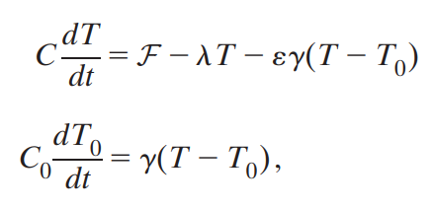
Before results, let’s understand how EEI trend depends on feedback and efficiency of deep ocean heat uptake
Two-layer EBM:
Net TOA is sum of these, i.e. total heat into the system:
N = F –λdT – (1- 𝜀)*𝛾(T-T₀)
With 𝜀=1 (ignore long term pattern effect) we recover standard formula:
N = F – λdT
So EEI trend is:
dN/dt = dF/dt - λ dT/dt

Slide 7
Let’s vary feedback parameter (λ)
For a given F, increasing λ implies system radiates more heat to space per K (by definition), which reduces EEI trend (i.e. dN/dt = dF/dt - λ dT/dt) (orange line).
However since system is more stable, dT/dt is also smaller (blue line), which somewhat compensates but λ impact dominates.

Slide 8
Let’s vary the efficiency of deep-ocean heat uptake (𝛾 – proportional to κ)
For a given F, increasing 𝛾 implies system more efficiently puts heat into the deeper-ocean, retaining less in the surface mixed-layer. Consequently surface dT reduces (blue line).
This impacts EEI trend (i.e. dN/dt = dF/dt - λ dT/dt) through dT/dt term with no change in λ. Since dT/dt smaller, dN/dt is is bigger.

Slide 9
All AOGCMs understate dN/dt (~0.25 Wm⁻² dec⁻¹) compared to CERES (~0.5 Wm-2 dec⁻¹).
Large obs κ suggests real world has been very efficient at putting heat into the deeper ocean over recent decades, whereas AOGCMs with a much smaller κ will have retained too much heat in their surface - mixed layer. This will increase dT/dt and reduce dN/dt in the AOGCMs relative to obs.
However λ is slightly too big in the AOGCMs. Therefore AOGCMs radiate too much heat to space per K -> also reduces dN/dt (but increases dT/dt).
In short: AOGCMs have biases in λ and κ that have opposing effects on dT/dt but both act to reduce dN/dt.
F=ρdT
N=F+λT
N=κdT

Slide 10
Now let’s look at the amip type runs.
In HadGEM3-GC3.1-LL the EEI trend gap is approximately halved when given observed SST and sea-ice -> a role for SST –atmospheric feedback pattern effects.
But it still understates dN/dt and there are known issues with BCs (i.e. too small SO warming trend in HadISST1, and SO sea-ice trends) so could be dataset dependent.
λ and κ distributions closer (but not perfect) to observed estimate when correct SST and sea-ice given, consistent with ideas that feedbacks AND ocean heat uptake efficiency depend on the pattern of SST change.

Slide 11
Issues & alternative hypothesis
CERES dN/dt is almost entirely explained by dF/dt. This leaves little to no radiative response (λdT) despite a significant dT/dt. Hence observed λ close to zero.
If this is the really case, it means the dN/dt trend seen in amip-piForcing (~-0.2 Wm⁻² dec) is not real.
This can all be reconciled if:
dF/dt in reality and AOGCMs was larger – more like 0.7 Wm⁻² K⁻¹. This would increase dN/dt in AOGCMs and amip (close the gap), while altering observed λ and κ calcs estimates in opposite directions.
And/or real world contained a random fluctuation (X) that is unrelated to global dT and not captured by AOGCMs or AGCM (winds perhaps?). Including X in dN = F + λ dT + X, would give opposite impacts on λ and κ – making reality look more like the AOGCMs in dN/dt, λ and κ.

